Slide 1

ODOO BUSINESS MODEL AND COMPETITIVE ANALYSIS
A Case Study on Market Position, Strengths, and Strategic Recommendations
Presented by Kirubha Mahesan

Slide 2
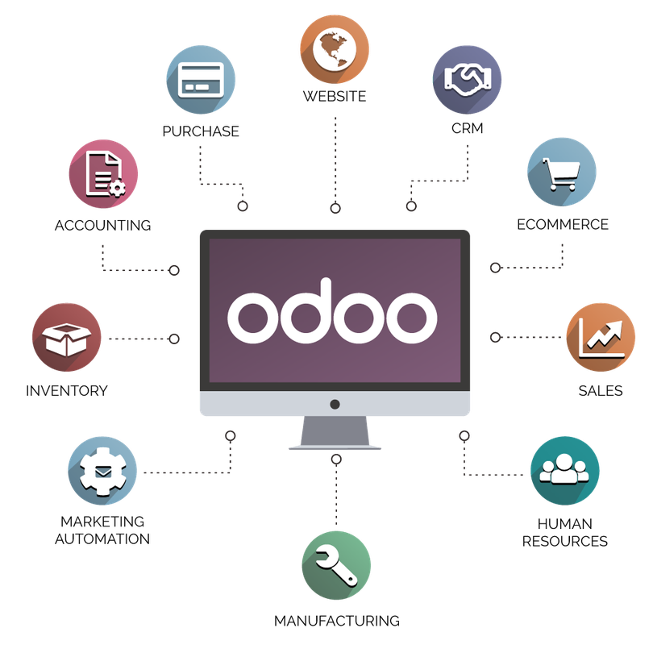
Introduction to Odoo
Odoo, formerly known as OpenERP, offers a comprehensive open-source suite of business applications designed to meet enterprise needs. This case study explores Odoo’s business model, market positioning, and competitive landscape, while offering strategic growth opportunities.

Slide 3

Odoo Business Model
Modular approach: Odoo offers over 30 applications and 16,000 third-party apps.
Revenue streams: SaaS subscription, on-premise installations, and a free community edition.
Targeted industries: Manufacturing, retail, services, healthcare, and education.

Slide 4
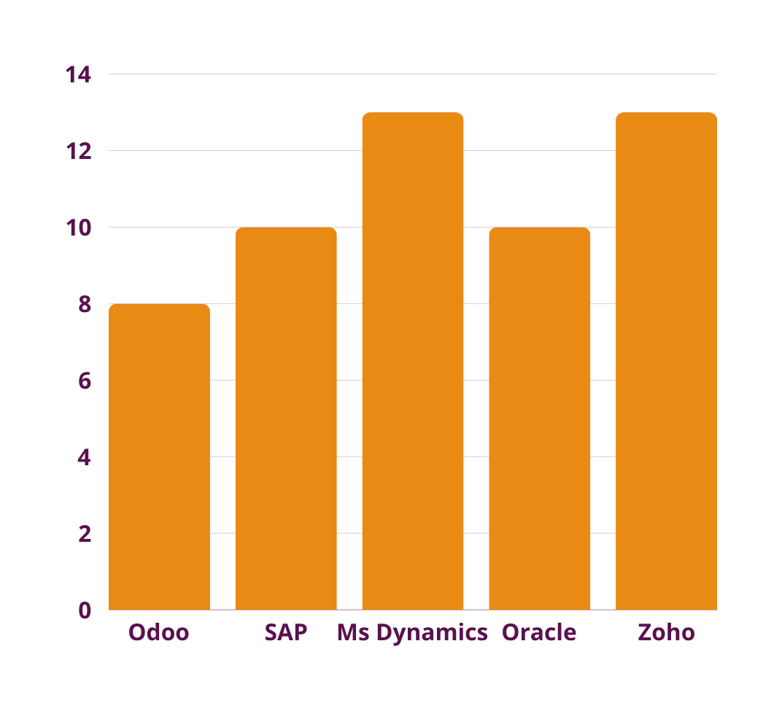
Market Position
Odoo has a growing market share in the SMB ERP sector.
Strong global presence, particularly in Europe, U.S., and emerging markets.
Competitors include SAP, Microsoft Dynamics, Oracle, and Zoho.

Slide 5





SWOT Analysis
Strengths
Weaknesses
Opportunities
Threats
Modular and cost-effective solution.
Open-source flexibility.
Complex customization.
Limited industry-specific features.
Growing cloud adoption.
Expansion in emerging markets.
Strong competition from ERP giants.
Rapid technology shifts.

Slide 6
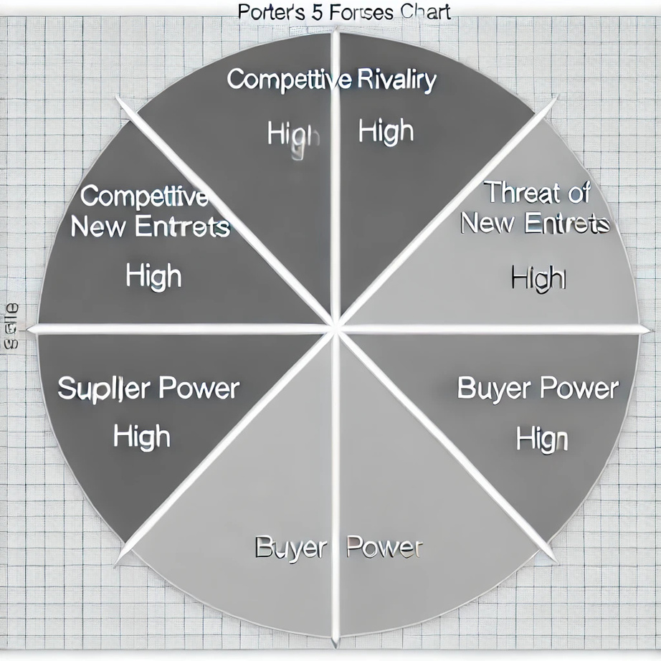
Porter’s 5 Forces Analysis
Competitive Rivalry
High competition from SAP, Microsoft, Oracle.
Threat of New Entrants
Moderate, especially in SMB ERP sector.
Supplier Power
Low, due to open-source platform.
Buyer Power
High, with multiple low-cost options.
Threat of Substitutes
Moderate, with cloud-native solutions.

Slide 7

PESTLE Analysis
Political: Regulatory requirements in key markets.
Economic: Growing SMB demand for affordable ERP solutions.
Social: Rising preference for cloud-based solutions.
Technological: Need for continuous innovation to keep up.
Legal: Compliance with GDPR and data protection laws.
Environmental: Opportunities in sustainability management solutions.

Slide 8


Conclusion
Odoo’s modular, open-source ERP system has positioned it as a cost-effective solution for SMBs. To sustain growth, Odoo must focus on expanding its cloud offerings, building vertical-specific solutions, and strengthening its global partnerships. With the right investments, Odoo can maintain a competitive edge in the rapidly evolving ERP market.

Slide 9




Strategic Recommendations
Expand cloud offerings: Strengthen Odoo’s SaaS model to compete with Oracle NetSuite and Dynamics 365.
Build industry-specific modules: Develop solutions tailored for healthcare, finance, and other sectors.
Strengthen partnerships: Expand partner ecosystem for better implementation and support in emerging markets.
Enhance customer retention: Implement loyalty programs to maintain customer base.

Slide 10

Citations
Odoo Official Website: https://www.odoo.com/
Statista ERP Market Reports
Gartner Reports on Enterprise Software
Competitor Information: SAP, Oracle, Microsoft Dynamics

Slide 11
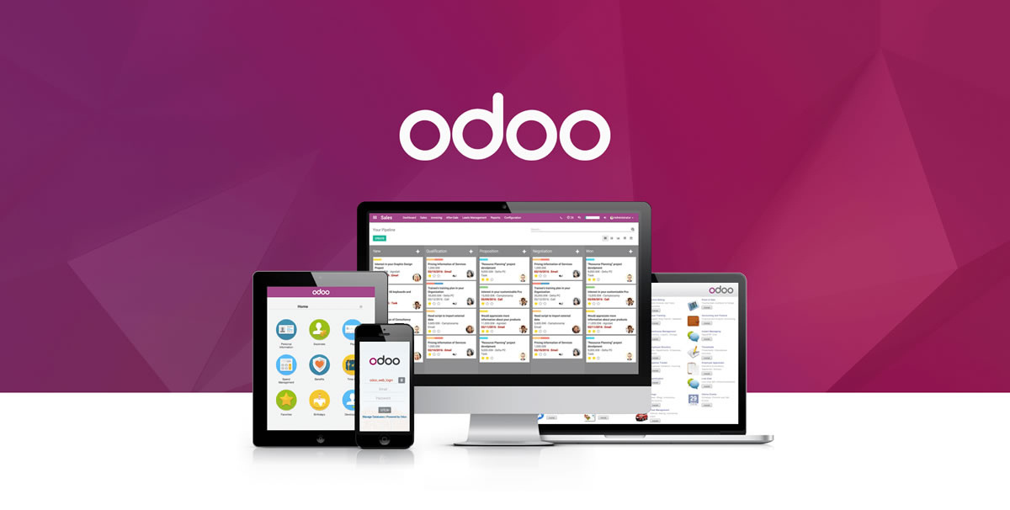
Thank you
Presented by Kirubha Mahesan

